Slide 1
Lecture 7
Hadoop/Spark

Slide 2
What is Hadoop
Hadoop is a software framework for distributed processing of large datasets across large clusters of computers
Large datasets → Terabytes or petabytes of data
Large clusters → hundreds or thousands of nodes
Hadoop is open-source implementation for Google MapReduce
Hadoop is based on a simple programming model called MapReduce
Hadoop is based on a simple data model, any data will fit

Slide 3
Design Principles of Hadoop
Need to process big data
Need to parallelize computation across thousands of nodes
Commodity hardware
Large number of low-end cheap machines working in parallel to solve a computing problem
This is in contrast to Parallel DBs
Small number of high-end expensive machines

Slide 4
Divide and Conquer
“Work”
Partition
w₁
w₂
w₃
“worker”
“worker”
“worker”
r₁
r₂
r₃
Combine
“Result”

Slide 5
It’s a bit more complex…
Fundamental issues
scheduling, data distribution, synchronization, inter-process communication, robustness, fault tolerance, …
Different programming models
Message Passing
Shared Memory
Memory
P₁
P₂
P₃
P₄
P₅
P₁
P₂
P₃
P₄
P₅
Architectural issues
Flynn’s taxonomy (SIMD, MIMD, etc.), network typology, bisection bandwidth UMA vs. NUMA, cache coherence
Different programming constructs
mutexes, conditional variables, barriers, …
masters/slaves, producers/consumers, work queues, …
Common problems
livelock, deadlock, data starvation, priority inversion…
dining philosophers, sleeping barbers, cigarette smokers, …
The reality: programmer shoulders the burden of managing concurrency…

Slide 6
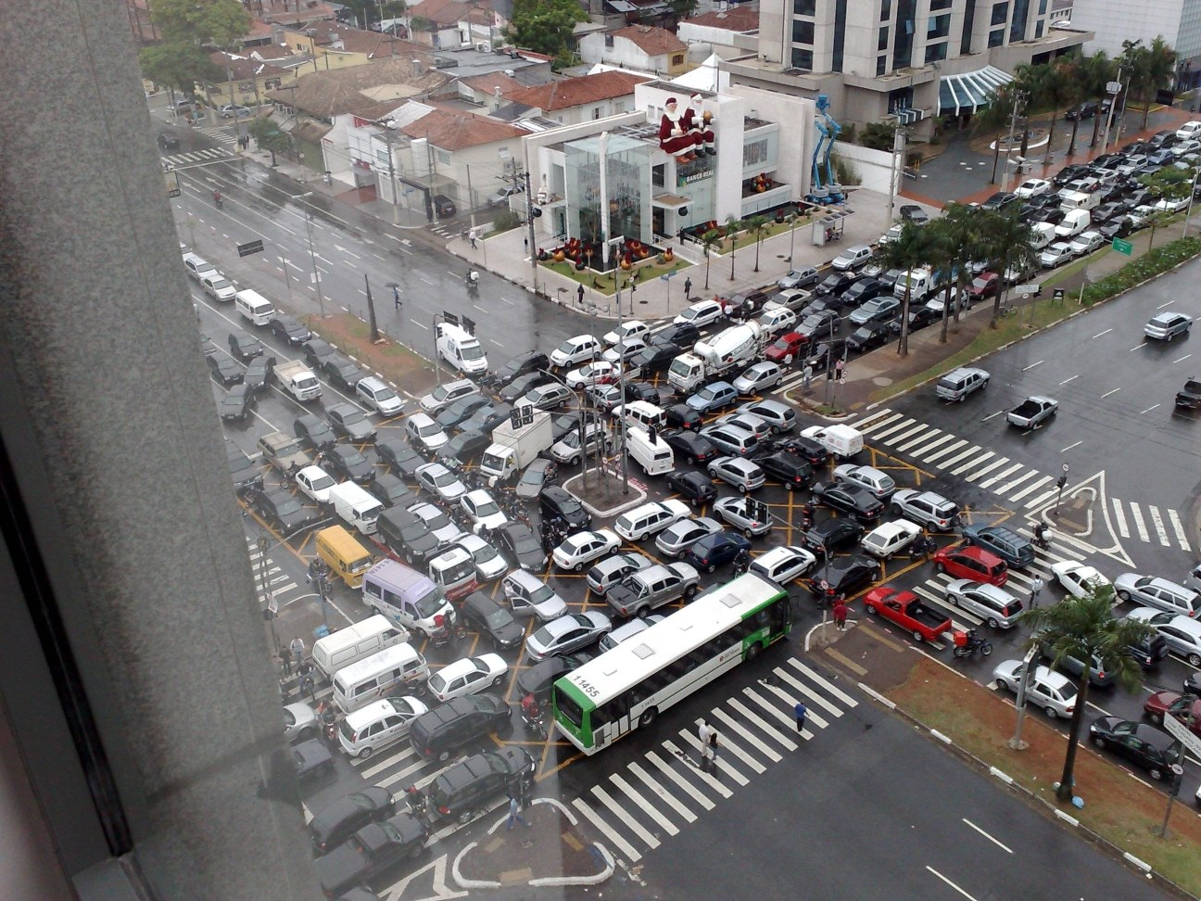
Source: Ricardo Guimarães Herrmann

Slide 7
Design Principles of Hadoop
Automatic parallelization & distribution
Hidden from the end-user
Fault tolerance and automatic recovery
Nodes/tasks will fail and will recover automatically
Clean and simple programming abstraction
Users only provide two functions “map” and “reduce”

Slide 8
Distributed File System
Don’t move data to workers… move workers to the data!
Store data on the local disks of nodes in the cluster
Start up the workers on the node that has the data local
Why?
Not enough RAM to hold all the data in memory
Disk access is slow, but disk throughput is reasonable
A distributed file system is the answer
GFS (Google File System)
HDFS for Hadoop (= GFS clone)

Slide 9
Hadoop: How it Works

Slide 10
Hadoop
HBase
Pig
Hive
Chukwa
MapReduce
HDFS
Zoo
Keeper
Core
Avro
Hadoop’s stated mission (Doug Cutting interview):
Commoditize infrastructure for web-scale,
data-intensive applications

Slide 11
Hadoop
HBase
Pig
Hive
Chukwa
Filesystems and I/O:
Abstraction APIs
RPC / Persistence
MapReduce
HDFS
Zoo
Keeper
Core
Avro

Slide 12
Hadoop
HBase
Pig
Hive
Chukwa
Cross-language serialization:
RPC / persistence
~ Google ProtoBuf / FB Thrift
MapReduce
HDFS
Zoo
Keeper
Core
Avro

Slide 13
Hadoop
Distributed execution (batch)
Programming model
Scalability / fault-tolerance
HBase
Pig
Hive
Chukwa
MapReduce
HDFS
Zoo
Keeper
Core
Avro

Slide 14
Hadoop
Distributed storage (read-opt.)
Replication / scalability
~ Google filesystem (GFS)
HBase
Pig
Hive
Chukwa
MapReduce
HDFS
Zoo
Keeper
Core
Avro

Slide 15
Hadoop
Coordination service
Locking / configuration
~ Google Chubby
HBase
Pig
Hive
Chukwa
MapReduce
HDFS
Zoo
Keeper
Core
Avro

Slide 16
Hadoop
HBase
Pig
Hive
Chukwa
MapReduce
HDFS
Zoo
Keeper
Column-oriented, sparse store
Batch & random access
~ Google BigTable
Core
Avro

Slide 17
Hadoop
HBase
Pig
Hive
Chukwa
MapReduce
HDFS
Zoo
Keeper
Data flow language
Procedural SQL-inspired lang.
Execution environment
Core
Avro

Slide 18
Hadoop
HBase
Pig
Hive
Chukwa
MapReduce
HDFS
Zoo
Keeper
Distributed data warehouse
SQL-like query language
Data mgmt / query execution
Core
Avro

Slide 19
Hadoop
HBase
Pig
Hive
Chukwa
… … more
MapReduce
HDFS
Zoo
Keeper
Core
Avro

Slide 20
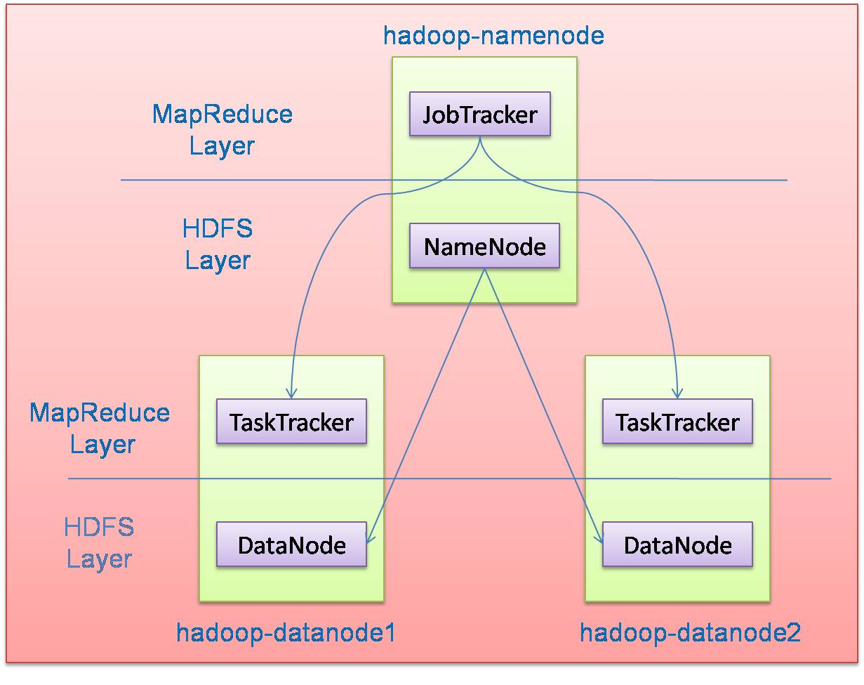
Hadoop Architecture
Distributed file system (HDFS)
Execution engine (MapReduce)
Master node (single node)
Many slave nodes

Slide 21
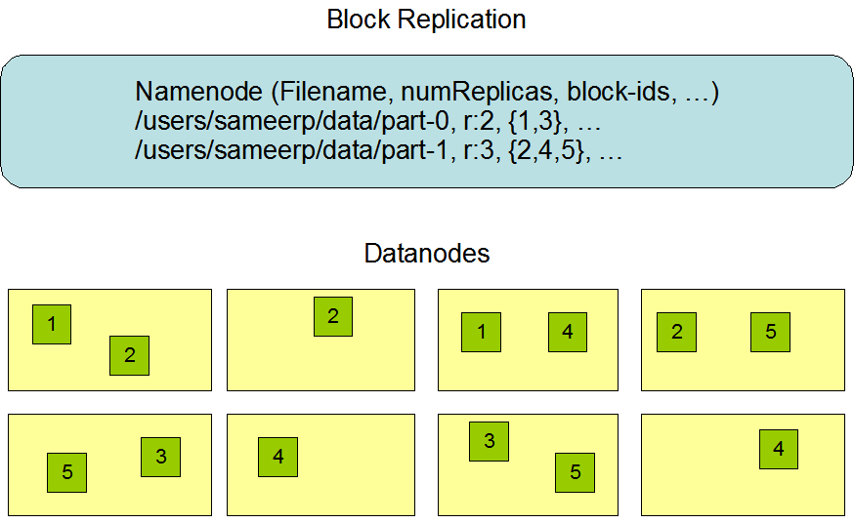
Hadoop Distributed File System (HDFS)
Centralized namenode
- Maintains metadata info about files
File F
1
2
3
4
5
Blocks (64 MB)
Many datanode (1000s)
- Store the actual data
- Files are divided into blocks
- Each block is replicated N times
(Default = 3)

Slide 22
Main Properties of HDFS
Large: A HDFS instance may consist of thousands of server machines, each storing part of the file system’s data
Replication: Each data block is replicated many times (default is 3)
Failure: Failure is the norm rather than exception
Fault Tolerance: Detection of faults and quick, automatic recovery from them is a core architectural goal of HDFS
Namenode is consistently checking Datanodes

Slide 23
Map-Reduce Execution Engine (Example: Color Count)
Input blocks on HDFS
Produces (k, v)
( , 1)
Shuffle & Sorting based on k
Consumes(k, [v])
( , [1,1,1,1,1,1..])
Produces(k’, v’)
( , 100)
Users only provide the “Map” and “Reduce” functions

Slide 24
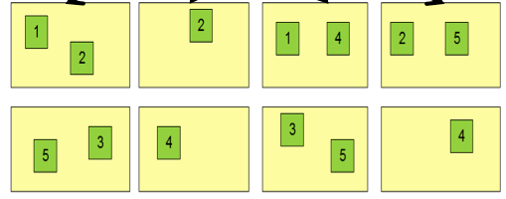
Properties of MapReduce Engine
Job Tracker is the master node (runs with the namenode)
Receives the user’s job
Decides on how many tasks will run (number of mappers)
Decides on where to run each mapper (concept of locality)
Node 1
Node 2
Node 3
This file has 5 Blocks → run 5 map tasks
Where to run the task reading block “1”
Try to run it on Node 1 or Node 3

Slide 25
Properties of MapReduce Engine (Cont’d)
Task Tracker is the slave node (runs on each datanode)
Receives the task from Job Tracker
Runs the task until completion (either map or reduce task)
Always in communication with the Job Tracker reporting progress
In this example, 1 map-reduce job consists of 4 map tasks and 3 reduce tasks

Slide 26
Key-Value Pairs
Mappers and Reducers are users’ code (provided functions)
Just need to obey the Key-Value pairs interface
Mappers:
Consume <key, value> pairs
Produce <key, value> pairs
Reducers:
Consume <key, <list of values>>
Produce <key, value>
Shuffling and Sorting:
Hidden phase between mappers and reducers
Groups all similar keys from all mappers, sorts and passes them to a certain reducer in the form of <key, <list of values>>

Slide 27
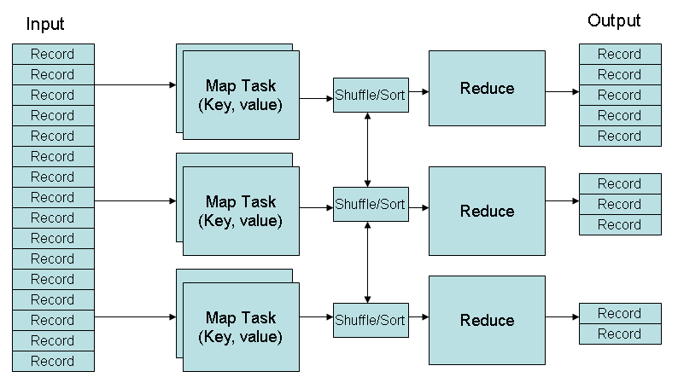
MapReduce Phases
Deciding on what will be the key and what will be the value ➔ developer’s responsibility

Slide 28
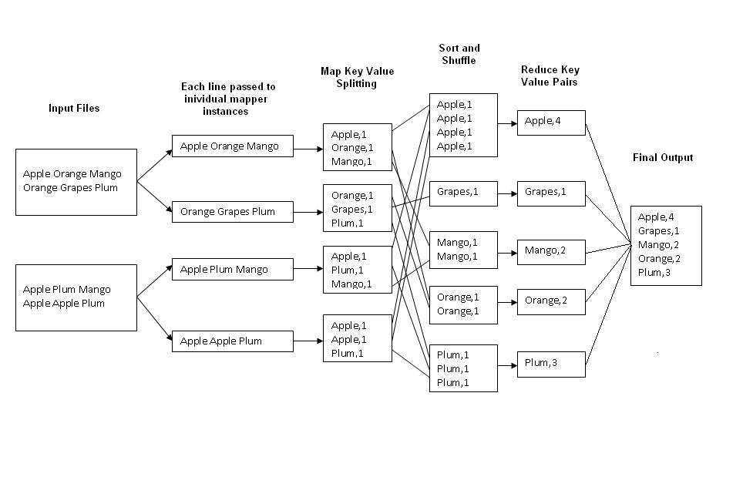
Example 1: Word Count
Job: Count the occurrences of each word in a data set
Map
Tasks
Reduce
Tasks

Slide 29
Example 2: Color Count
Job: Count the number of each color in a data set
Input blocks on HDFS
Produces (k, v)
( , 1)
Shuffle & Sorting based on k
Consumes(k, [v])
( , [1,1,1,1,1,1..])
Produces(k’, v’)
( , 100)
Part0001
Part0002
Part0003
That’s the output file, it has 3 parts on probably 3 different machines

Slide 30
Example 3: Color Filter
Job: Select only the blue and the green colors
Each map task will select only the blue or green colors
No need for reduce phase
Input blocks on HDFS
Produces (k, v)
( , 1)
Write to HDFS
Part0001
Write to HDFS
Part0002
That’s the output file, it has 4 parts on probably 4 different machines
Write to HDFS
Part0003
Write to HDFS
Part0004

Slide 31
MapReduce – KMeans
KmeansIter()
Map(p) // Assign Cluster
For c in clusters:
If dist(p,c)<minDist, then minC=c, minDist = dist(p,c)
Emit(minC.id, (p, 1))
Reduce() //Update Centroids
For all values (p, c) :
total += p; count += c;
Emit(key, (total, count))
Map1
Map2
Initial centroids

Slide 32
MapReduce – KMeans
KmeansIter()
Map(p) // Assign Cluster
For c in clusters:
If dist(p,c)<minDist, then minC=c, minDist = dist(p,c)
Emit(minC.id, (p, 1))
Reduce() //Update Centroids
For all values (p, c) :
total += p; count += c;
Emit(key, (total, count))
Map: assign each p to closest centroids
1
3
Reduce: update each centroid with its new location (total, count)
2
4
Map1
Map2
Initial centroids
Reduce1
Reduce2

Slide 33
MapReduce kNN
K=3
Map()
Input:
All points
query point p
Output: k nearest neighbors (local)
Emit the k closest points to p
1
0
1
1
1
0
1
0
1
1
1
0
0
0
0
1
0
Reduce()
Input:
Key: null; values: local neighbors
query point p
Output: k nearest neighbors (global)
Emit the k closest points to p among all local neighbors
Map1
Map2
Query point
Reduce

Slide 34
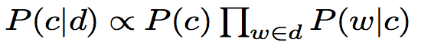
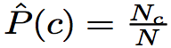
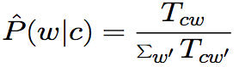
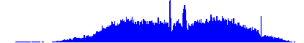

Naïve Bayes
c is a class label, d is a doc, w is a word
Formulation:
Parameter estimation
Class prior:
Conditional probability:
where N_{c} is #docs in c, N is #docs
T_{cw} is # of occurrences of w in class c
d1
Goals:
total number of docs N
number of docs in c:N_{c}
word count histogram in c:T_{cw}
total word count in c:∑T_{cw’}
d2
c1:
N₁=3
T_{1w}
d3
d4
T_{2w}
d5
c2:
N₂=4
d6
d7
Term vector

Slide 35
MapReduce: Naïve Bayes
ClassPrior()
Map(doc): Emit(class_id, (doc_id, doc_length)
Combine()/Reduce()
N_{c} = 0; sTcw = 0
For each doc_id:
N_{c}++; sTcw +=doc_length
Emit(c, (N_{c} , sTcw))
Goals:
total number of docs N
number of docs in c:N_{c}
word count histogram in c:T_{cw}
total word count in c:∑T_{cw’}
ConditionalProbability()
Map(doc):
For each word w in doc:
Emit(pair(c, w) , 1)
Combine()/Reduce()
T_{cw} = 0
For each value v: T_{cw} += v
Emit(pair(c, w) , T_{cw})
Naïve Bayes can be implemented using MapReduce jobs of histogram computation

Slide 36
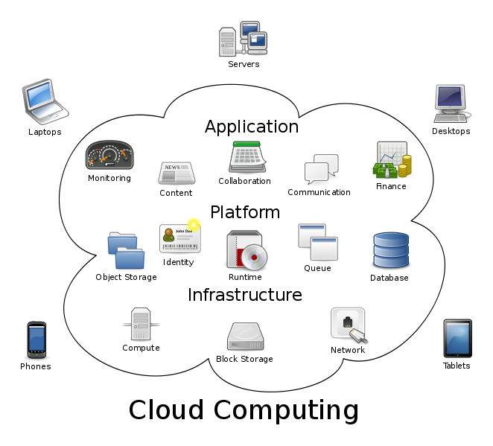
Bigger Picture: Hadoop vs. Other Systems
 | Distributed Databases | Hadoop
Computing Model | Notion of transactions Transaction is the unit of work Concurrency control | Notion of jobs Job is the unit of work No concurrency control
Data Model | Structured data with known schema Read/Write mode | Any data will fit in any format (un)(semi)structured ReadOnly mode
Cost Model | Expensive servers | Cheap commodity machines
Fault Tolerance | Failures are rare Recovery mechanisms | Failures are common over thousands of machines Simple yet efficient fault tolerance
Key Characteristics | - Efficiency, optimizations, fine-tuning | - Scalability, flexibility, fault tolerance
Cloud Computing
A computing model where any computing infrastructure can run on the cloud
Hardware & Software are provided as remote services
Elastic: grows and shrinks based on the user’s demand
Example: Amazon EC2

Slide 37
SPARK

Slide 38
Limitations of MapReduce
MapReduce is great at one-pass computation, but inefficient for multi-pass algorithms
No efficient primitives for data sharing » State between steps goes to distributed file system » Slow due to replication & disk storage

Slide 39
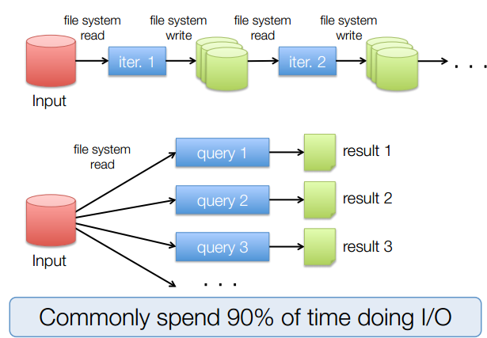
Example: Iterative Apps

Slide 40
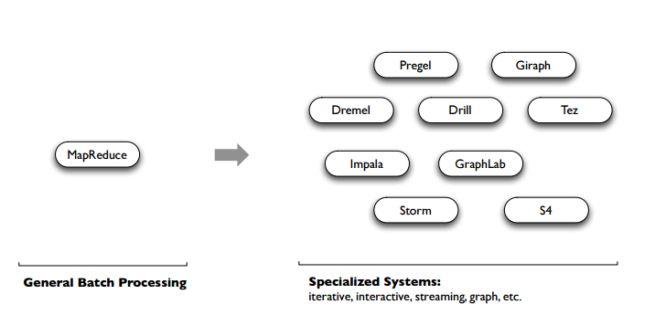
Spark
Unlike the various specialized systems, Spark’s goal was to generalize MapReduce to support new apps within same engine. This allows for an approach which is more efficient for the engine, and much simpler for the end users
Notes:
Mention that first there was a general batch system for all big data processing (MapReduce)
Then recently came the short period of specialized systems, but they were quite complicated and different from each other to learn
Spark is trying to unify the most popular processing paradigms

Slide 41


Motivation
(2007 – 2015?)
(2004 – 2013)
Giraph
(2014 – ?)
Pregel
Tez
Drill
Dremel
Mahout
Storm
S4
Impala
GraphLab
General Batch Processing
General Unified Engine
Specialized Systems
(iterative, interactive, ML, streaming, graph, SQL, etc)

Slide 42
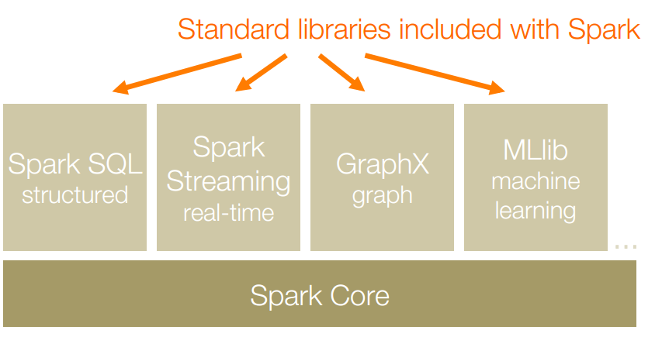
Apache Spark is a fast and general-purpose cluster computing system. It also supports a rich set of higher-level tools including Spark SQL for SQL and structured data processing, MLlib for machine learning, GraphX for graph processing, and Spark Streaming for streaming processing.

Slide 43
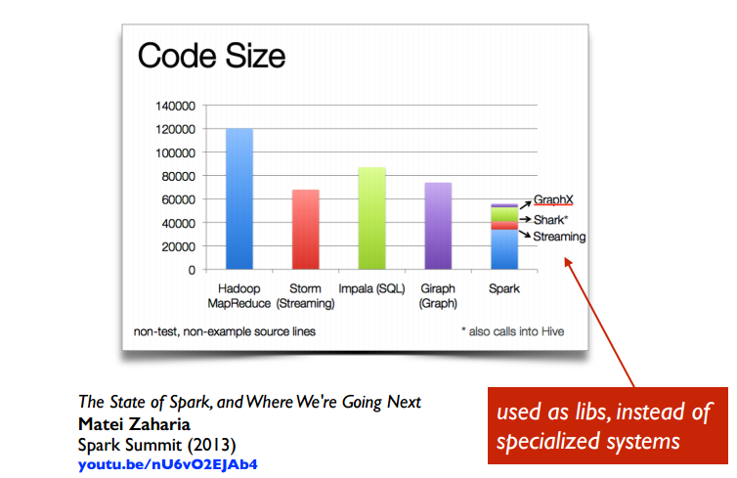

Slide 44
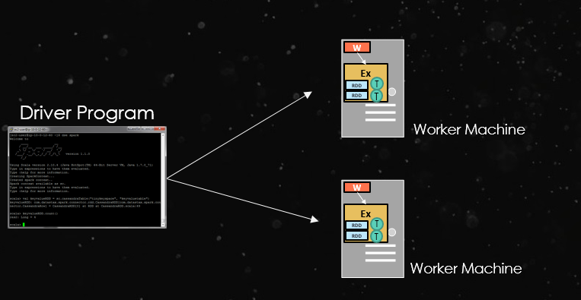
Basic Concept
At a high level, every Spark application consists of
a driver program that runs the user’s main function and
executes various parallel operationson a cluster.

Slide 45
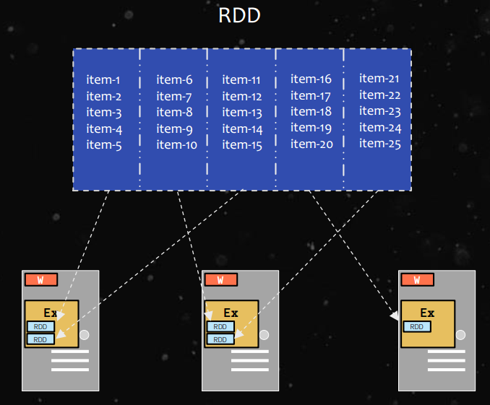
Basic Concept
The main abstraction in Spark is that of a resilient distributed dataset (RDD), which represents a read-only collection of objects partitioned across a set of machines that can be rebuilt if a partition is lost.

Slide 46
Creation of RDD
An RDD can be created 2 ways:
Parallelize a collection
Read data from an external source (S3, C*, HDFS, etc)
// Parallelize in Scala
val wordsRDD= sc.parallelize(List("fish", "cats", "dogs"))
//read data from an external source: val lines = sc.textFile(...)

Slide 47
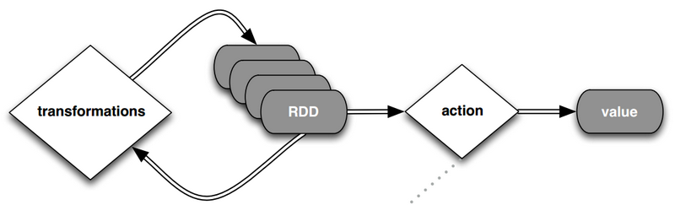
Operations on RDD
RDDs support two types of operations: transformations, which create a new dataset from an existing one, and actions, which return a value to the driver program after running a computation on the dataset.

Slide 48
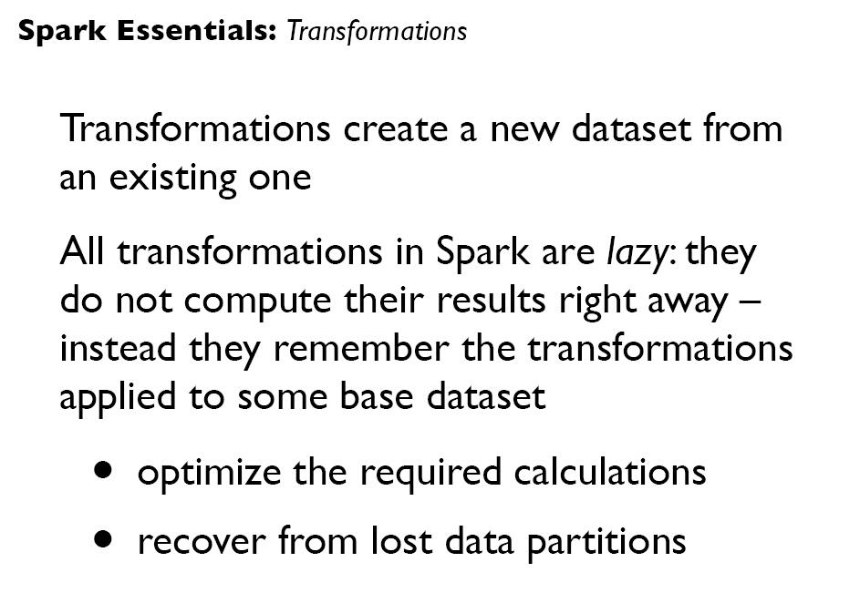

Slide 49
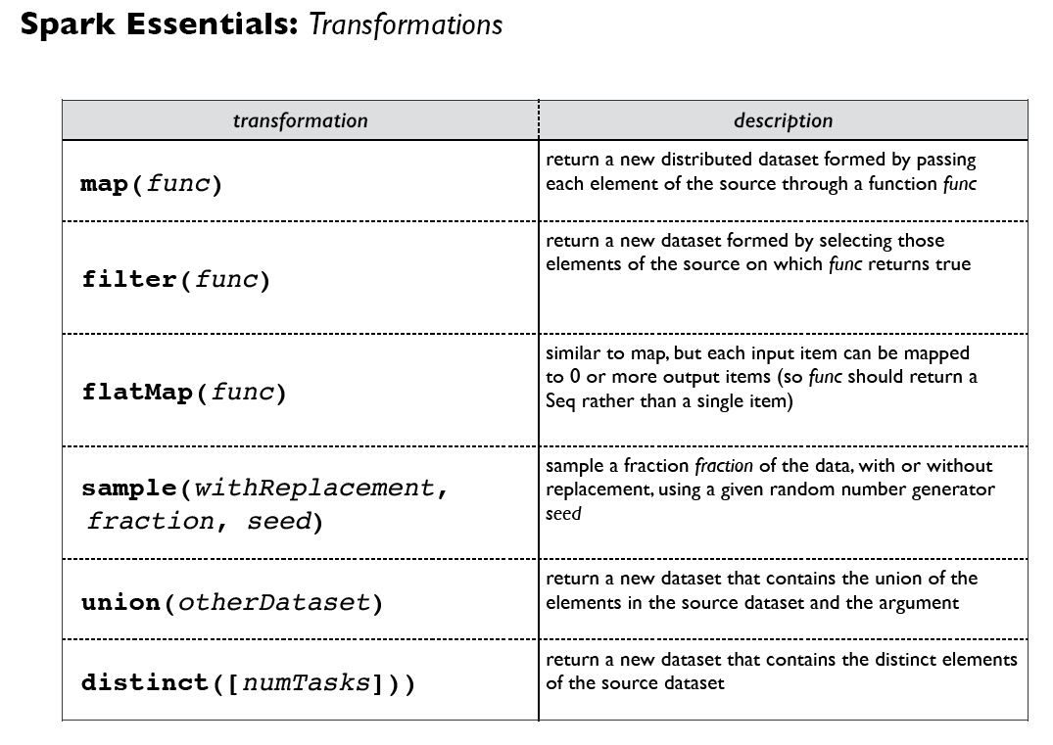

Slide 50
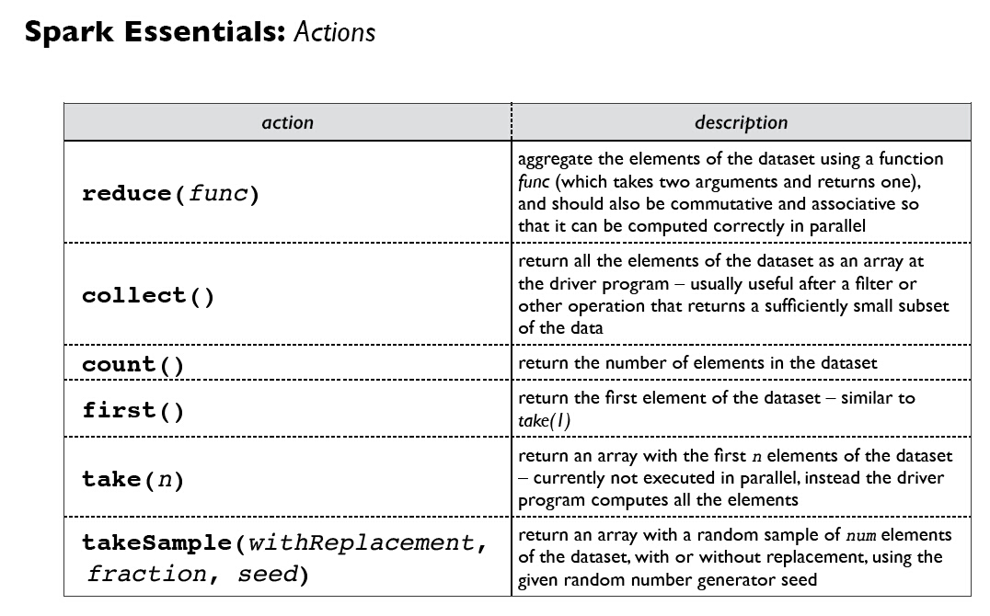

Slide 51
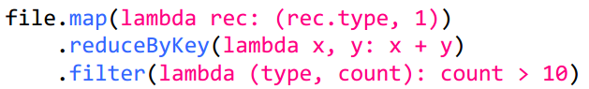
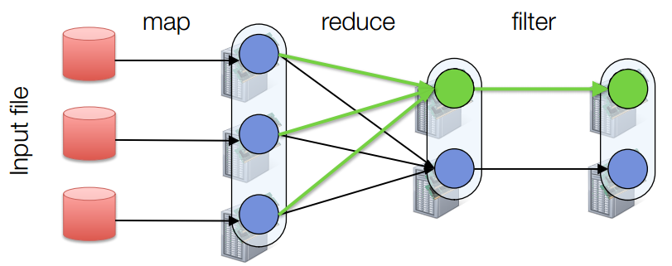
Fault Tolerance
RDDs track lineage info to rebuild lost data

Slide 52
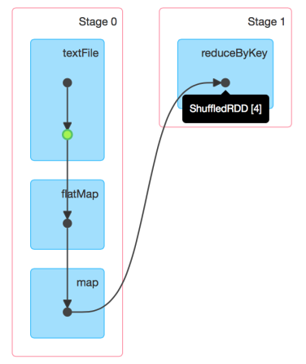
DAG of Word Count
Stage Graph
Needs to compute my parents, parents, parents, etc all the way back to an RDD with no dependencies .
Hadoop RDD
FilterMap RDD
Map RDD
Automatically rebuilt on failure

Slide 53
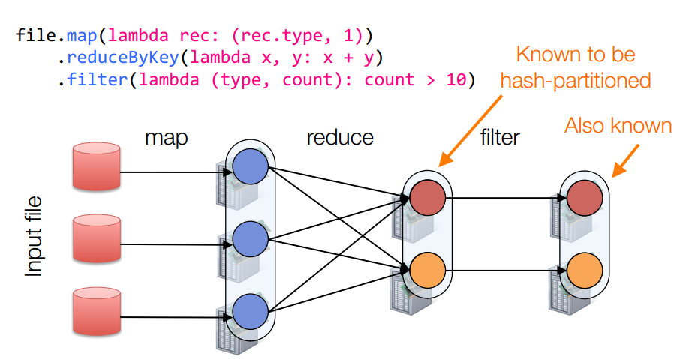
Partitioning
RDDs know their partitioning functions

Slide 54
Word Count of Spark
val lines = sc.textFile(“hamlet.txt”)
val counts = lines.flatMap( line=> line.split(“ ”)) .map(word => (word, 1)) .reduceByKey((x,y)=> x + y).collect()
textFile
flatMap
map
reducebyKey
“to” “be” “or”
(to, 1) (be, 1) (or, 1)
(be, 2) (not, 1)
(be, 2) (not, 1)
“to be or”
(or, 1)
(to, 2)
“not” “to” “be”
(not, 1) (to, 1) (be, 1)
(or, 1)
(to, 2)
“not to be”
Partition
RDD

Slide 55
MapReduce VS Spark
MapReduce
Great at one-pass computation, but inefficient for multi-pass algorithms.
No efficient primitives for data sharing.
Spark
Extends a programming language with a distributed collection data-structure（RDD）.
Clean APIs in Java, Scala, Python, R.

Slide 56
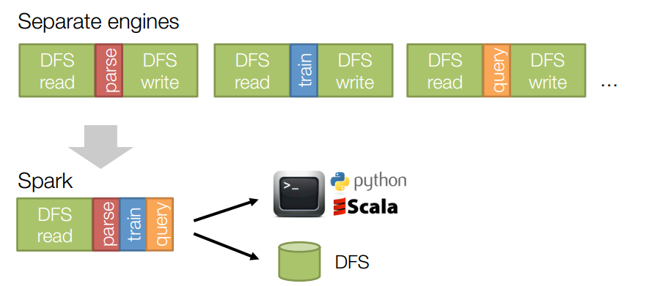
MapReduce VS Spark
Same engine performs data extraction, model training and interactive queries

Slide 57



HBase
HBase
Cloudera Manager
Management
MapReduce
Spark
HBase
Phoenix
Coordination Services
Parallel Computing Framework
Parallel Computing Framework
Distributed Database
SQL on HBase
Zookeeper
HDFS
Distributed File System

Slide 58
HBase
Contents
HBase
Data Storage
HBase Table
Row key
Compression
Write / Read data
Security & Fault Tolerance
Phoenix
HBase Configuration
Talk is cheap. Show you the code.

Slide 59
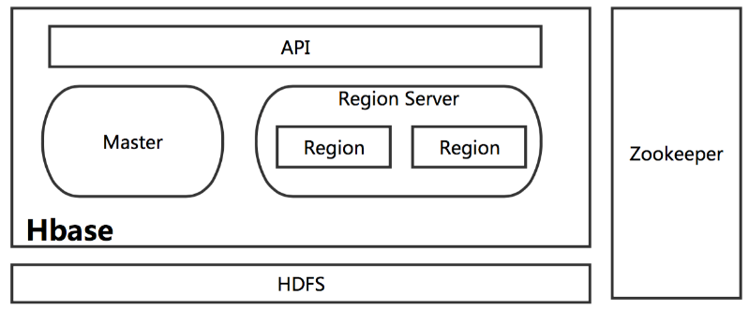
HBase
What is HBase
Distributed Database
Non-relational database modeled after Google's Bigtable
Based on HDFS
NoSQL
Stores data in a columnar format (列式存储)

Slide 60
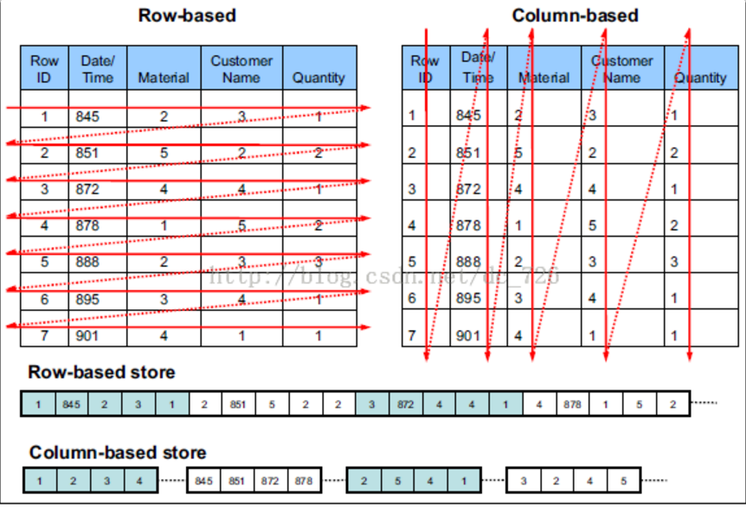
HBase
Col V.S. Row
Compression

Slide 61
HBase
Why HBase
Big data
Col-based storage: compression, compact, col appending
Build on HDFS: scalability
High Concurrency
Build on HDFS:
LSM Tree: writing (more focusing on it)
Notes:
类型一致方便压缩，数据存储紧凑，不会储存空值

Slide 62
HBase
Why HBase
Big data
Col-based storage: compression, compact, col appending
Build on HDFS: scalability
High Concurrency
Build on HDFS:
LSM Tree: writing (more focusing on it)
Sorted row-keys: may help reading operation
Reliability
Build on HDFS
HA implemented by Zookeeper
WAL
Notes:
类型一致方便压缩，数据存储紧凑，不会储存空值，rowkey查询相当快

Slide 63
HBase
Why NOT HBase
Complex transactions / Queries
join…
Low delay
……
Notes:
类型一致方便压缩，数据存储紧凑，不会储存空值

Slide 64
HBase
Table Format
RDBMS
HBase
ID | First name | Last name
1 | San | Zhang
2 | Si | Li
Row-key | CF:Column-key | Timestamp | Cell Value
1 | info:fn | 123455 | San
1 | info:ln | 123455 | Zhang
2 | info:fn | 123456 | Si
2 | info:ln | 123456 | Li

Slide 65
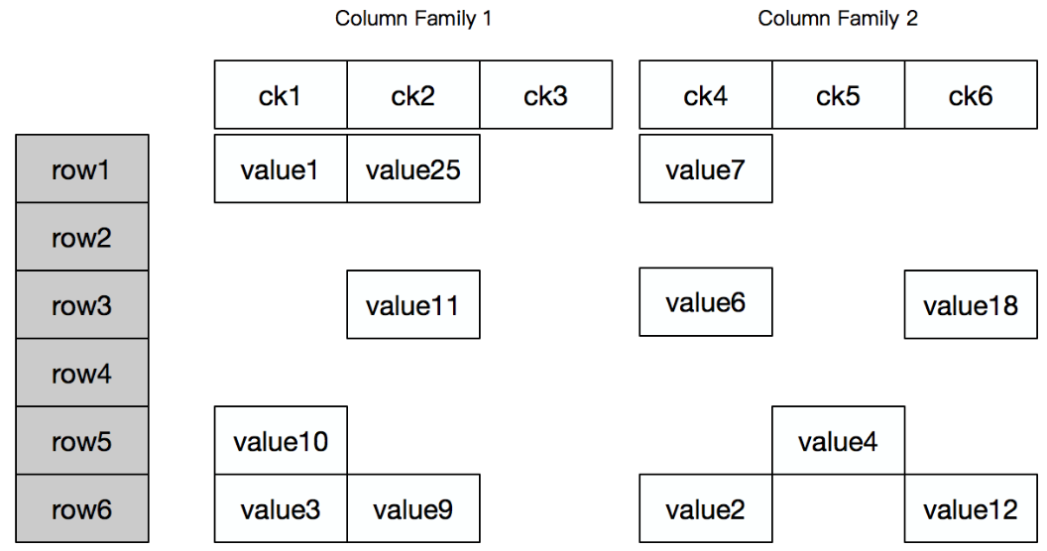
HBase
HBase Table
Table format
Row-key is unique for a row
Notes:
Rowkey是有排序 存储的

Slide 66
HBase
HBase Table
Table format
CF: group of columns

Slide 67
HBase
HBase Table
Table format
Cell: Row-key+CF:col+timestemp

Slide 68
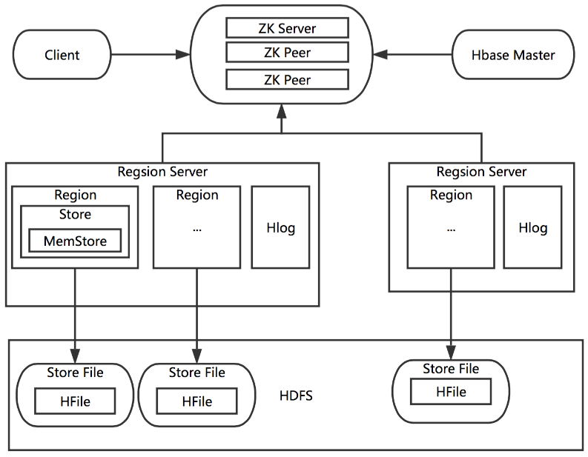
HBase
Overview
Coordination service for Region Server
Assign Region to Region Server
Load balance
Allow Multiple masters (like hadoop)
Table ops (create, delete)

Slide 69
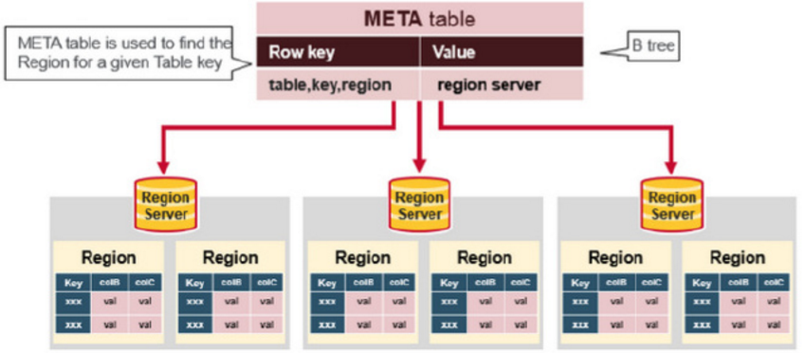
HBase
Overview
HBase HA. Make sure only one master is active
HBase meta-data
Monitor the activity of Region Server and send report to master
Addr., start/end key of regions

Slide 70
HBase
Overview
Store:
MemStore
Store File
Notes:
可以看做，Region中存储了有序的行，Region中的store存储了这些行的列，一个store一个cf

Slide 71
HBase
Overview
Handle Region I/O
Handle Region split
HeartBeat
HeartBeat
Store data
One Region only store the data of one CF

Slide 72
HBase
Overview
HLog:
Write­-Ahead-­Log
Record event before modifying MemStore

Slide 73
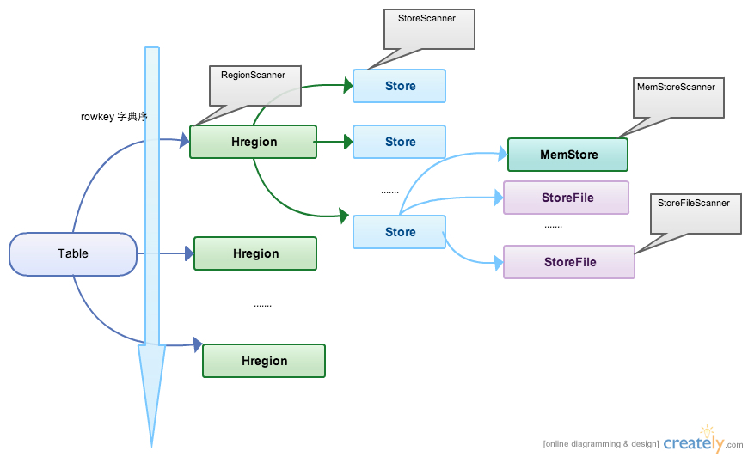
HBase
Data Storage
Notes:
Region 按大小分割的，每个表开始只有一个 region ，随着数据增多， region 不断增大，当增大到一个阀值的时候，region就会等分会两个新的region，之后会有越来越多的region

Slide 74
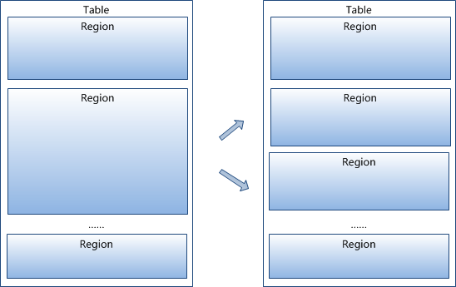
HBase
Region Split
Data
WAL
Reading is inconvenient! → Blockcache
Write
OK
MemStore
Flush
StoreFile
StoreFile
Compact
StoreFile
Notes:
每次都要写WAL，IO很蛋疼

Slide 75

Zookeeper
Zookeeper
Cloudera Manager
Management
Hive
HBase
Solr
Distributed Data Warehouse
Distributed Indexing
Distributed Database
MapReduce
Spark
Phoenix
Coordination Services
Zookeeper
Parallel Computing Framework
Parallel Computing Framework
SQL on HBase
HDFS
Distributed File System

Slide 76
Zookeeper
Contents
Apache ZooKeeper is an effort to develop and maintain an open-source server which enables highly reliable distributed coordination.
ZooKeeper is a centralized service for maintaining configuration information, naming, providing distributed synchronization, and providing group services.

Slide 77

Cloudera Manager
CDH
Cloudera Manager
Management
Hive
HBase
Solr
Distributed Data Warehouse
Distributed Indexing
Distributed Database
MapReduce
Spark
Phoenix
Coordination Services
Zookeeper
Parallel Computing Framework
Parallel Computing Framework
SQL on HBase
HDFS
Distributed File System

Slide 78
Cloudera Manager
CDH
Automated deployment and configuration.
Customizable monitoring and reporting.
Effortless, robust troubleshooting.
Zero downtime maintenance.

Slide 79






Web Service
ES-Hadoop
HDFS

Slide 80
Web Request
Get
Web Controller
Question
Query By Question
ESQueryObject
On Error
ESQuery
Results
RDD
Spark Calculation
Question

Slide 81
Thank You

